Slide 1


Slide 2
TEST AUTOMATION
PROJECT
Automating Myntra Website
 | NAME | ROLL NO | SAP ID | BATCH
 | Kushagra Bansal | R171218116 | 500067414 | B2
 | Chitranshi Mishra | R171218034 | 500069567 | B1

Slide 3
Selenium
Selenium is a free (open-source) automated testing framework used to validate web applications across different browsers and platforms. You can use multiple programming languages like Java, C#, Python etc to create Selenium Test Scripts. Testing done using the Selenium testing tool is usually referred to as Selenium Testing.
The benefits of Selenium Test Automation :-
1.Open-Source: As mentioned earlier, the biggest strength of Selenium is that it is a freeware and a portable tool. It has no upfront direct costs involved. The tool can be freely downloaded and the community-based support for it is freely available.
2.Language support: Selenium supports a range of languages, including Java, Perl, Python, C#, Ruby, Groovy, JavaScript, and more. It has its own script, but it is not limited by that language. It can work with various languages – whatever the developers/testers are comfortable with.
3. Supports Operating Systems: Selenium can operate and support across multiple Operating Systems (OS) like Windows, Mac, Linux, and UNIX.
4.Support across browsers: Selenium provides support across multiple browsers, namely, Internet Explorer, Chrome, Firefox, Opera, and Safari. This becomes highly resourceful while executing tests and testing it across various browsers simultaneously.

Slide 4
Selenium
5.Support for programming languages and framework: Selenium integrates with programming languages and various frameworks. For instance, it can integrate with ANT or Maven type of framework for source code compilation. Further, it can integrate with the TestNG framework for testing applications and reporting purposes. It can integrate with Jenkins or Hudson for Continuous Integration (CI) and can even integrate with other open-source tools to support other features.
6.Tests across devices: Selenium Test Automation can be implemented for mobile web application automation on Android, iPhone, and Blackberry. This can help in generating necessary results and address issues on a continuous basis.
7.Constant updates: Selenium support is community–based, which enable constant updates and upgrades. These upgrades are readily available and do not require specific training. This makes Selenium resourceful and cost-effective as well.
8.Loaded Selenium suites: Selenium is not just a singular tool or utility, it a loaded package of various testing tools and so, is referred to as a Suite. Each tool is designed to cater to different testing needs and requirements of test environments. Additionally, Selenium comes with capabilities to support Selenium IDE, Selenium Grid, and Selenium Remote Control (RC).

Slide 5
JUNIT vs TestNG
Junit | Testng
TestNG is a Java-based framework that is an upgraded option for running tests. | TestNG can run parallel tests.
JUnit is an open-source framework used to trigger and write tests. | JUnit is an open-source framework used to trigger and write tests.
It does not support advanced annotations. | It supports advanced annotations.
The dependency tests are missing in JUnit. | Dependency tests are present in TestNG.
Grouping tests together is not possible. | Tests can be grouped together and run parallel.
Tests can be grouped together and run parallel. | Writing tests and configuring them is easy in TestNG than Junit.

Slide 6
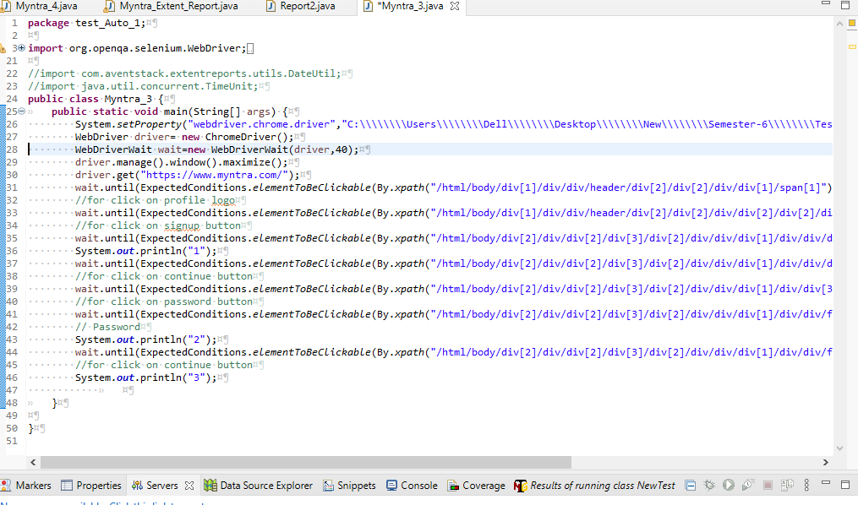
Script For Myntra Login Page

Slide 7
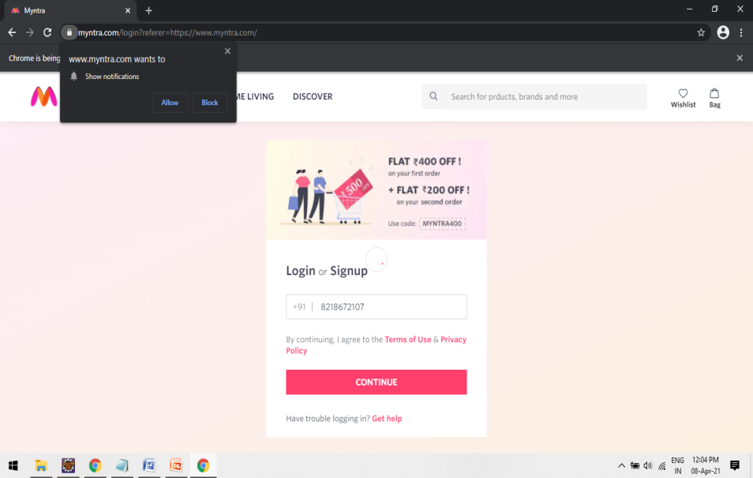
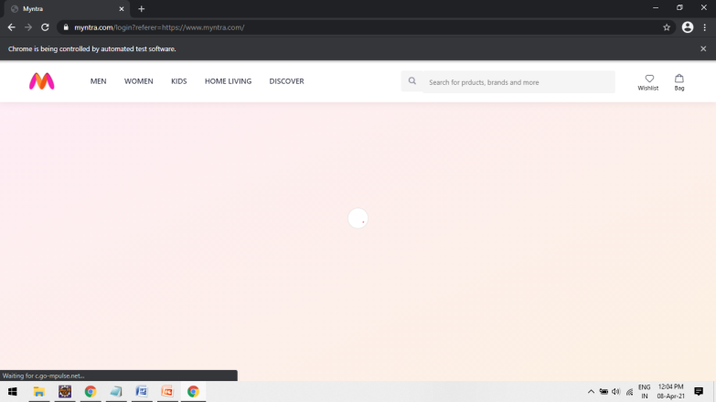
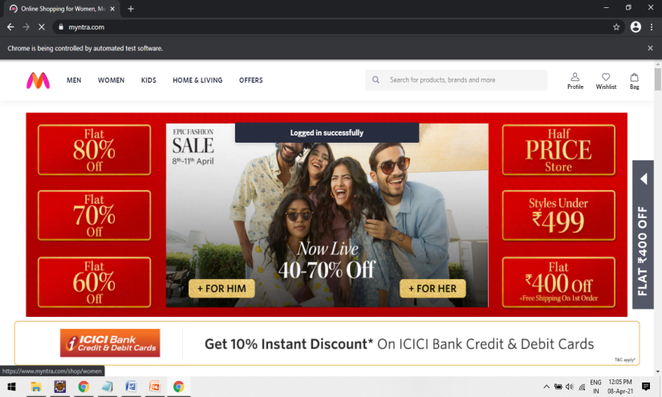
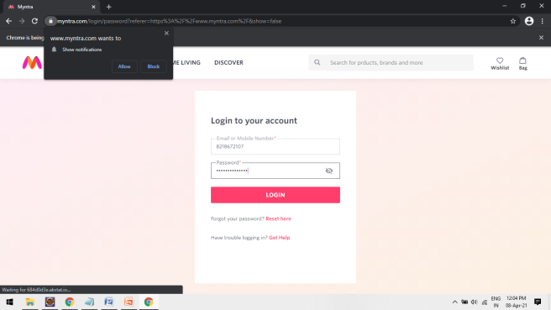
Outcome’s

Slide 8
Searching a Product
public class Myntra_4 {
public static void main(String[] args) {
System.setProperty("webdriver.chrome.driver","C:\\\\\\\\Users\\\\\\\\Dell\\\\\\\\Desktop\\\\\\\\New\\\\\\\\Semester-6\\\\\\\\Test Automation\\\\\\\\Chrome_Driver_89\\\\\\\\chromedriver.exe");
WebDriver driver= new ChromeDriver();
WebDriverWait wait=new WebDriverWait(driver,40);
driver.manage().window().maximize();
driver.get("https://www.myntra.com/");
// WebElement Number = driver.findElement(By.id("mobileNumberPass"));
wait.until(ExpectedConditions.elementToBeClickable(By.xpath("/html/body/div[1]/div/div/header/div[2]/div[2]/div/div[1]/span[1]"))).click();
//for click on profile logo
wait.until(ExpectedConditions.elementToBeClickable(By.xpath("/html/body/div[1]/div/div/header/div[2]/div[2]/div/div[2]/div[2]/div[2]/div[1]/a"))).click();
//for click on signup button
wait.until(ExpectedConditions.elementToBeClickable(By.xpath("/html/body/div[2]/div/div[2]/div[3]/div[2]/div/div/div[1]/div/div/div[2]/div[2]/div[1]/input"))).sendKeys("8755210395");
System.out.println("1");
wait.until(ExpectedConditions.elementToBeClickable(By.xpath("/html/body/div[2]/div/div[2]/div[3]/div[2]/div/div/div[1]/div/div/div[2]/div[2]/div[3]"))).click();
//for click on continue button
wait.until(ExpectedConditions.elementToBeClickable(By.xpath("/html/body/div[2]/div/div[2]/div[3]/div[2]/div/div/div[1]/div/div[3]/span"))).click();
//for click on password button
wait.until(ExpectedConditions.elementToBeClickable(By.xpath("/html/body/div[2]/div/div[2]/div[3]/div[2]/div/div/div[1]/div/div/form/div/div[2]/input"))).sendKeys("Aaaaaaaa@121");
// Password
System.out.println("2");

Slide 9
Searching a Product
wait.until(ExpectedConditions.elementToBeClickable(By.xpath("/html/body/div[2]/div/div[2]/div[3]/div[2]/div/div/div[1]/div/div/form/div/div[3]/button"))).click();
//for click on continue button
System.out.println("3");
wait.until(ExpectedConditions.elementToBeClickable(By.xpath("/html/body/div[1]/div/div/header/div[2]/div[3]/input"))).click();
wait.until(ExpectedConditions.elementToBeClickable(By.xpath("/html/body/div[1]/div/div/header/div[2]/div[3]/input"))).sendKeys("Shoes");
wait.until(ExpectedConditions.elementToBeClickable(By.xpath("/html/body/div[1]/div/div/header/div[2]/div[3]/a/span"))).click();
// Product Searching
System.out.println("4");
wait.until(ExpectedConditions.elementToBeClickable(By.cssSelector("#desktopSearchResults > div.search-searchProductsContainer.row-base > section > ul > li:nth-child(1) > a > div.product-imageSliderContainer > div"))).click();
// Product Description
//Men White Trainers
System.out.println("5");
// assertTrue(wait.until(ExpectedConditions.elementToBeClickable(By.cssSelector("#desktopSearchResults > div.search-searchProductsContainer.row-base > section > ul > li:nth-child(1) > a > div.product-imageSliderContainer > div"))).isEnabled());
ArrayList<String> noOftabs = new ArrayList<String>(driver.getWindowHandles());
System.out.println("No of tbs" + noOftabs);
System.out.println("6");
// System.out.println("Title matching"); // Title of Product
// String value = wait.until(ExpectedConditions.elementToBeClickable(By.xpath("/html/body/div[2]/div/div/div/main/div[2]/div[2]/div[1]/h1[2]"))).getText();
// assertEquals(value, "Men White Trainers");
// System.out.println("Title matched correctly \n\n");
}
}

Slide 10
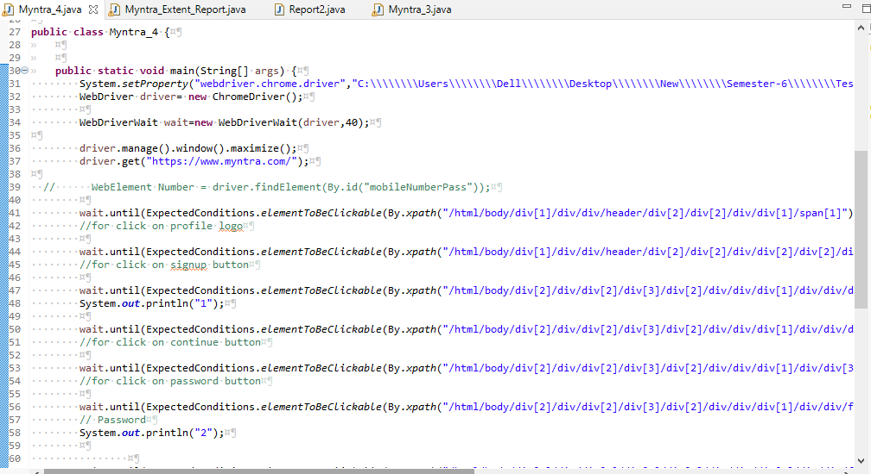
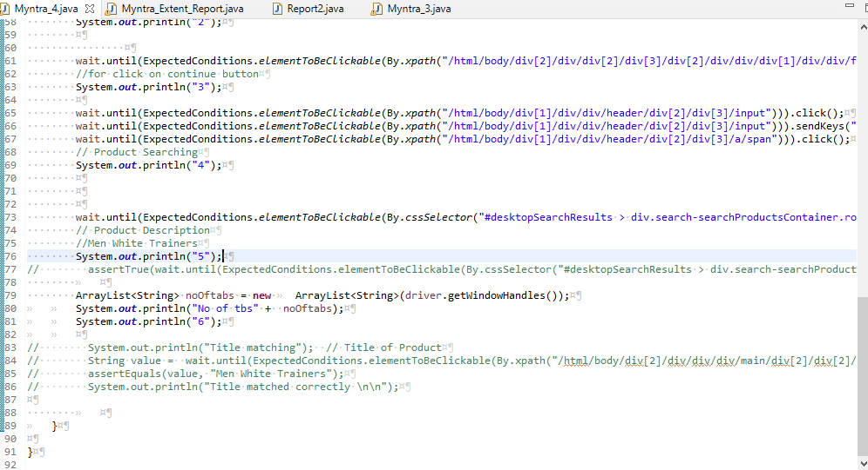
Searching a Product

Slide 11
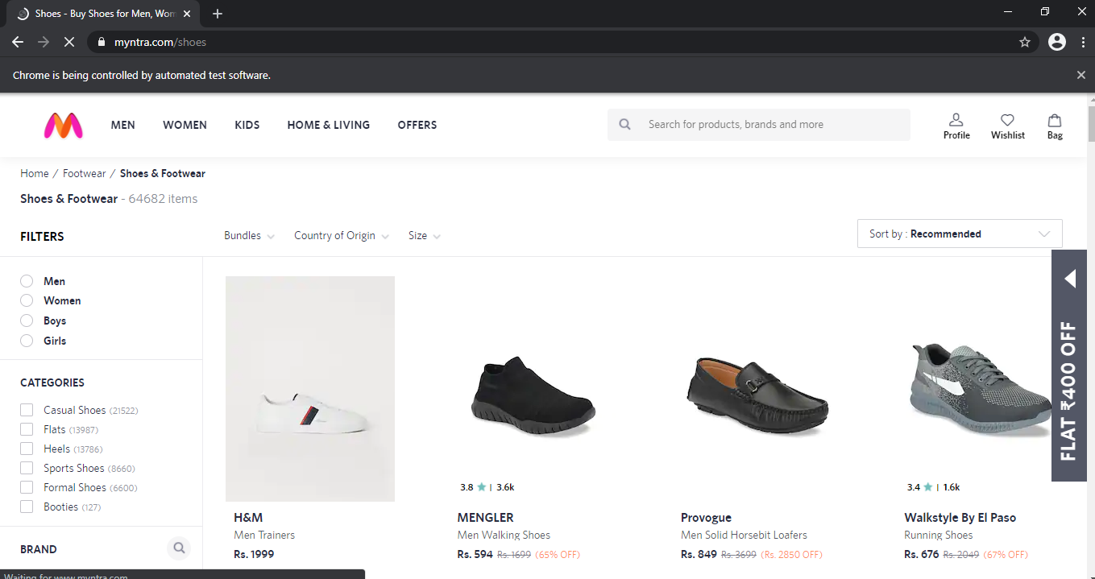
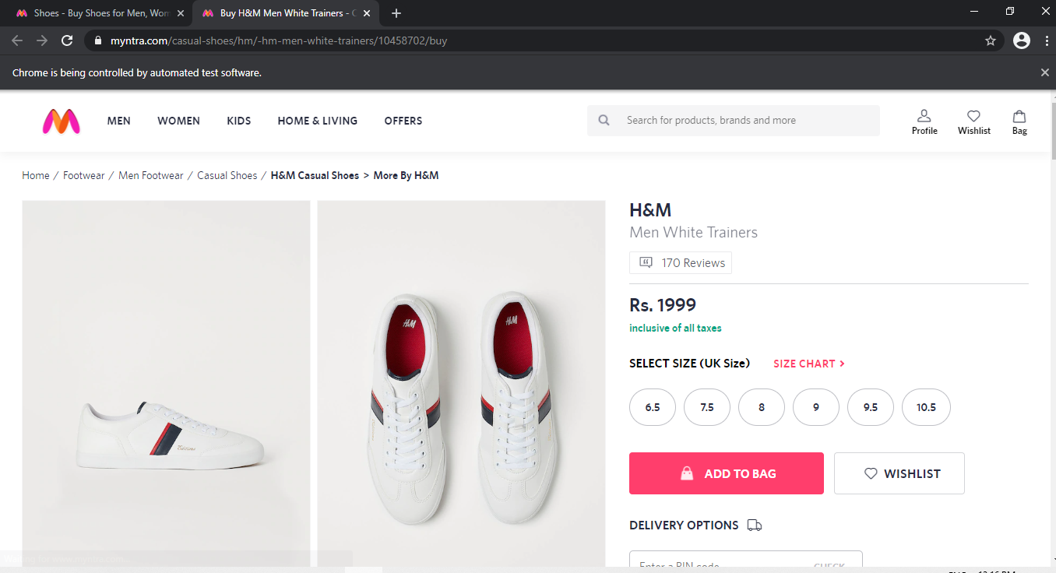
Outcome

Slide 12
Generating Exntent Report using TestNG suite
Aim:
From Login to ordering the product & Unloading the
product From cart

Slide 13
Script
Extent Report Script and Outputs =>
https://github.com/kushagra67414/Myntra_Automation_Using_Selenium/tree/main/Generate%20Extent%20Report
Report Results => https://github.com/kushagra67414/Myntra_Automation_Using_Selenium/tree/main/Generate%20Extent%20Report/Report%20Results
Unloading Products =>
https://github.com/kushagra67414/Myntra_Automation_Using_Selenium/tree/main/UnloadingProduct

Slide 14
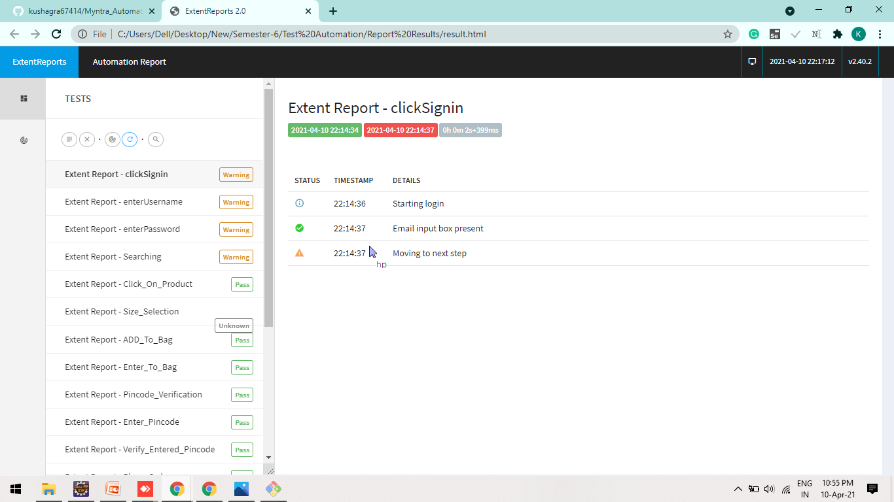
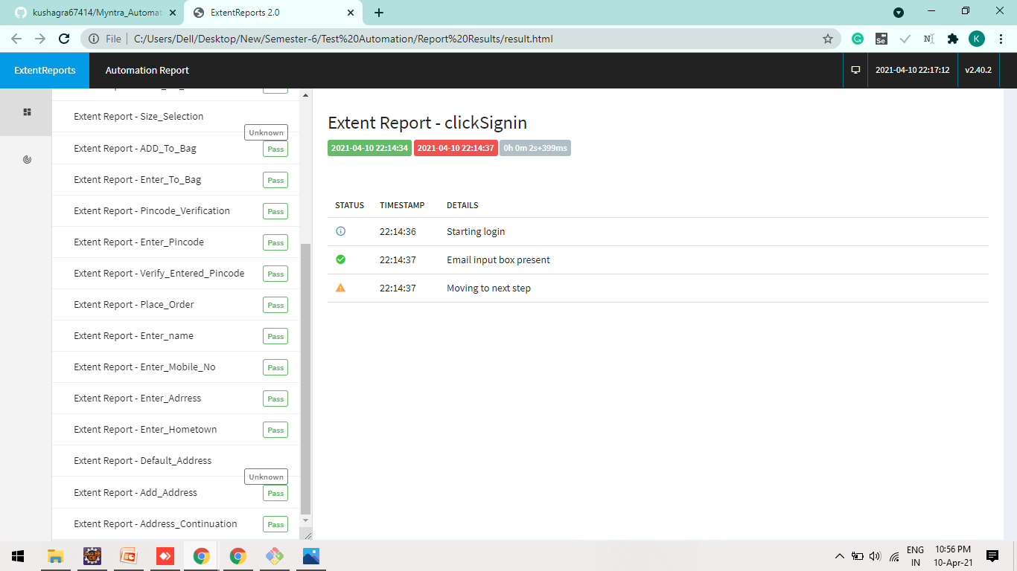
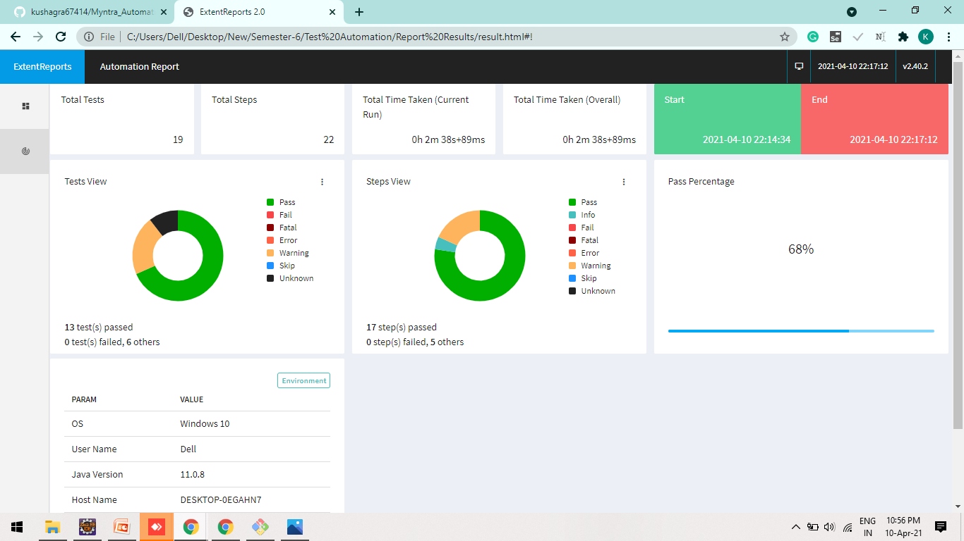
Report Results

Slide 15
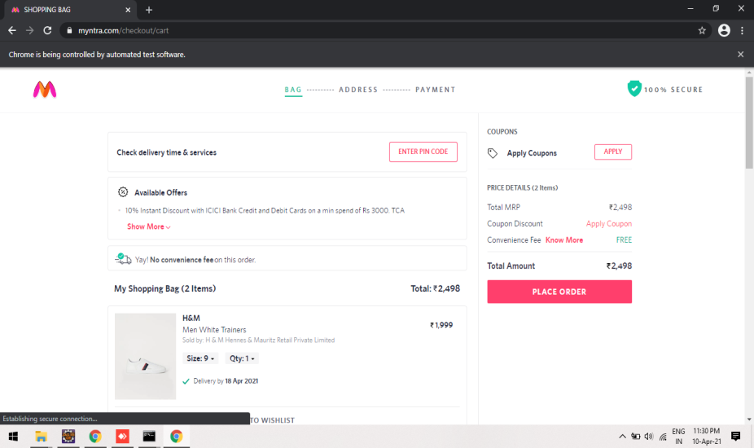
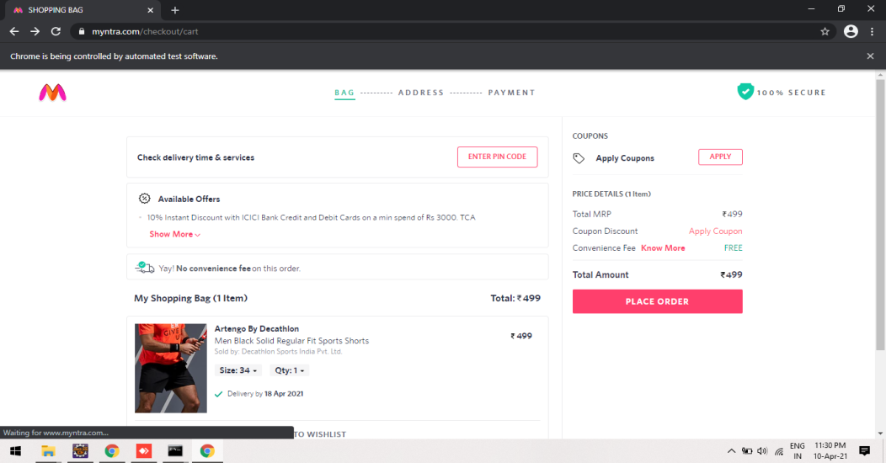
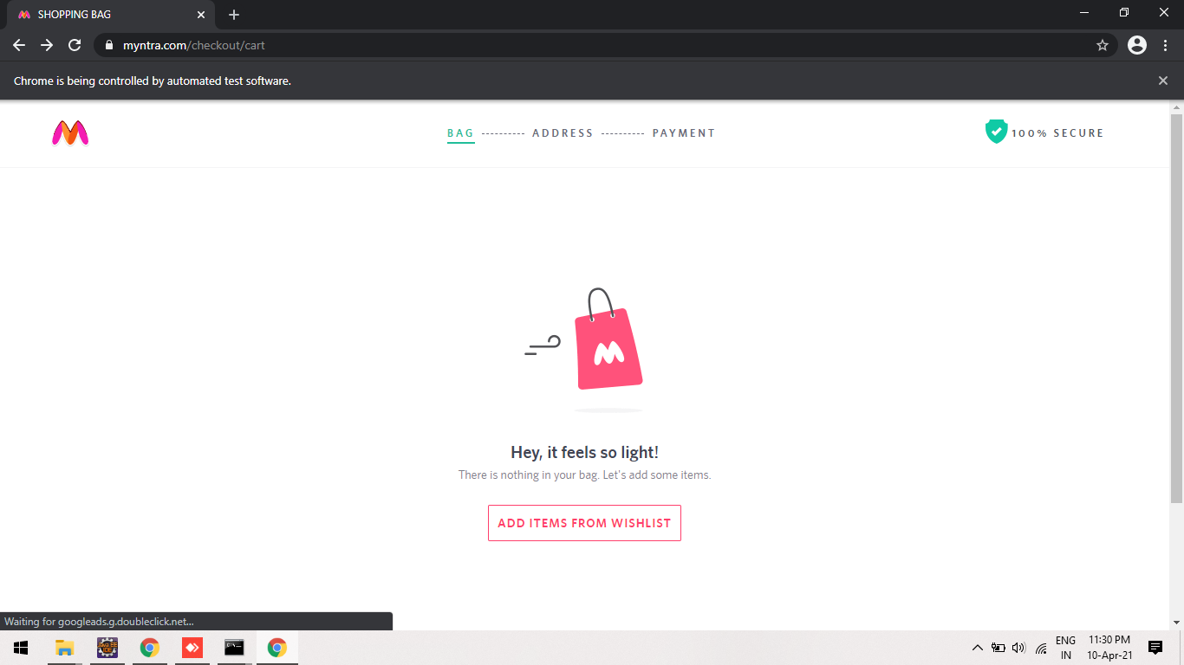
UnloadingProduct Outputs

Slide 16
THANK YOU

